Slide 1
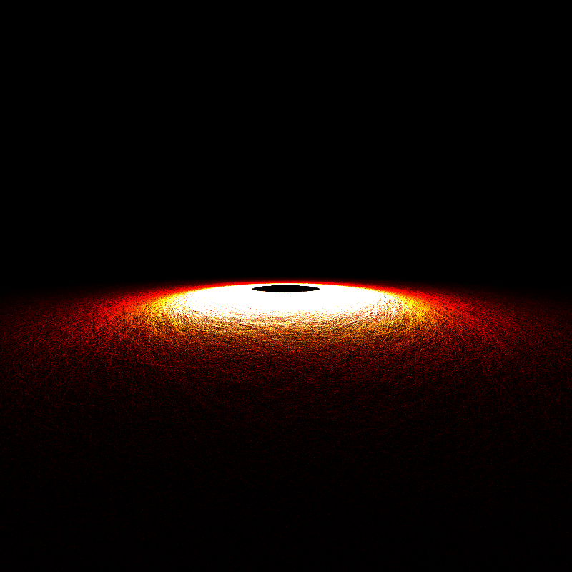

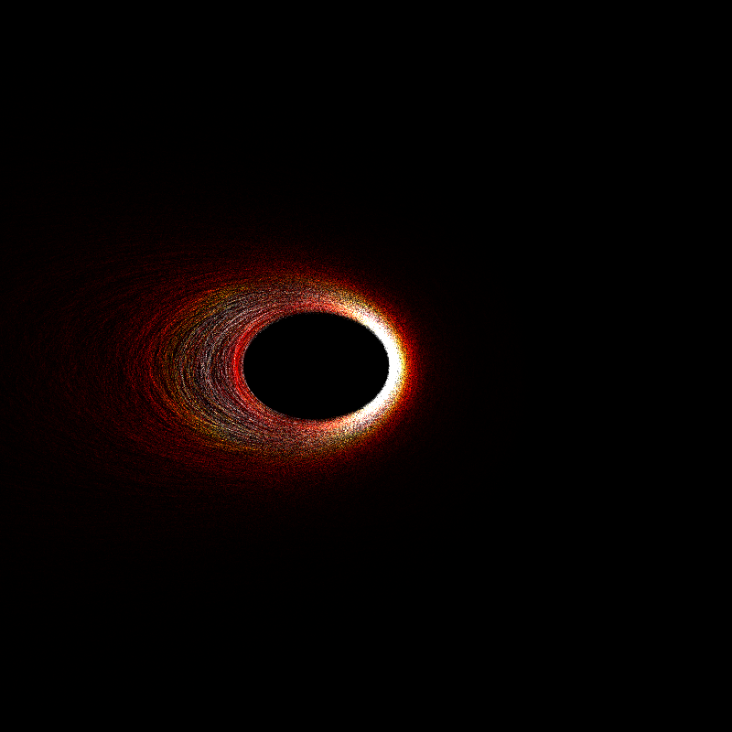
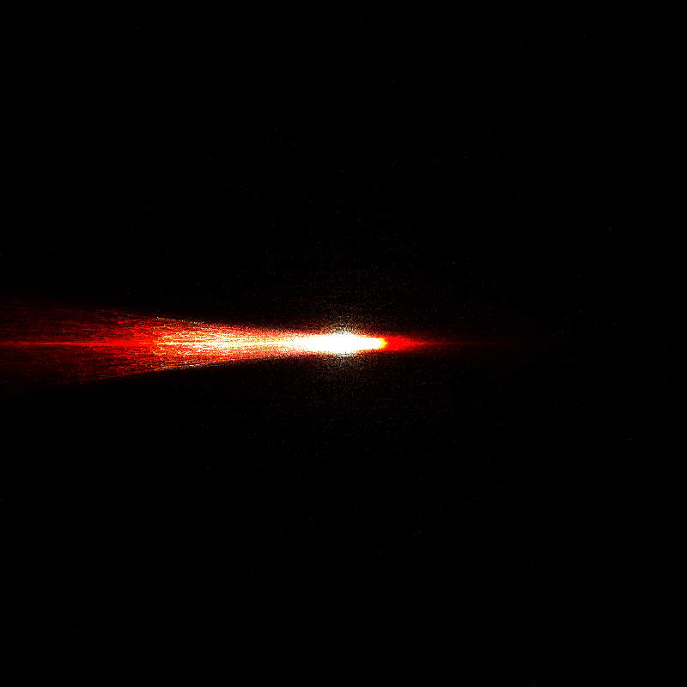
“moth"
𝜑 = 85°
𝜃 = -180°
“needle”
𝜑 = 90°
𝜃 = 90°
“eccentric ring”
𝜑 = 5°
𝜃 = 90°
“ship and wake”
𝜑 = 90°
𝜃 = 90°

Slide 2
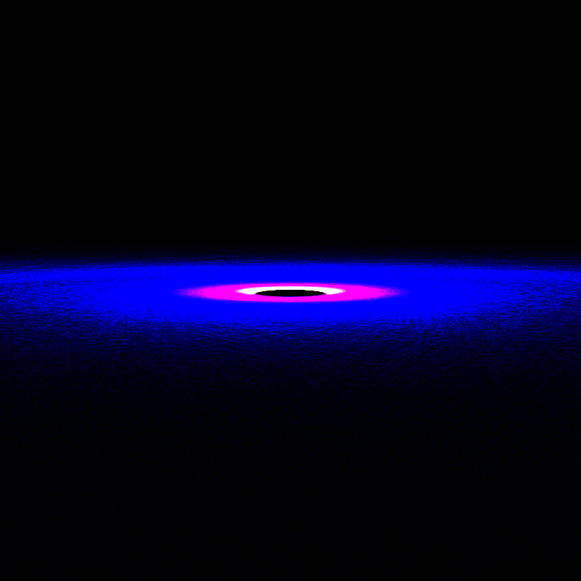

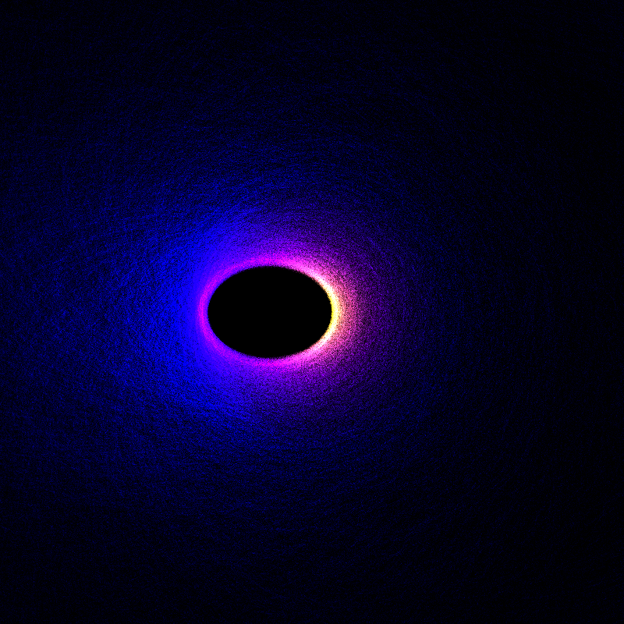
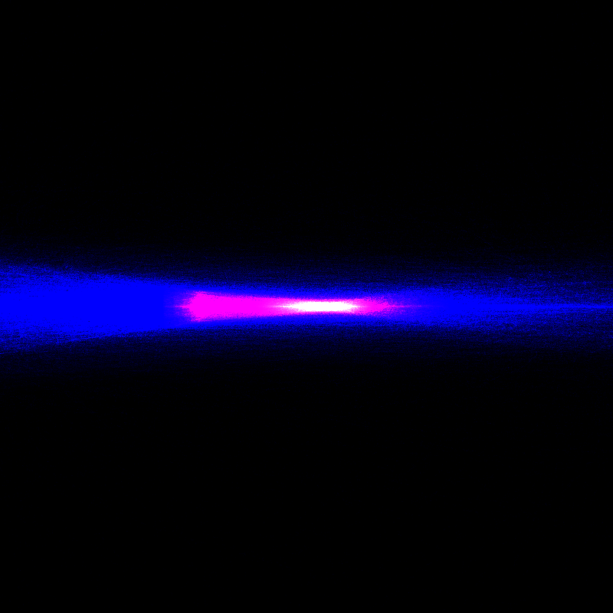
“moth"
𝜑 = 85°
𝜃 = -180°
“needle”
𝜑 = 90°
𝜃 = 90°
“eccentric ring”
𝜑 = 5°
𝜃 = 90°
“ship and wake”
𝜑 = 90°
𝜃 = 90°

Slide 3
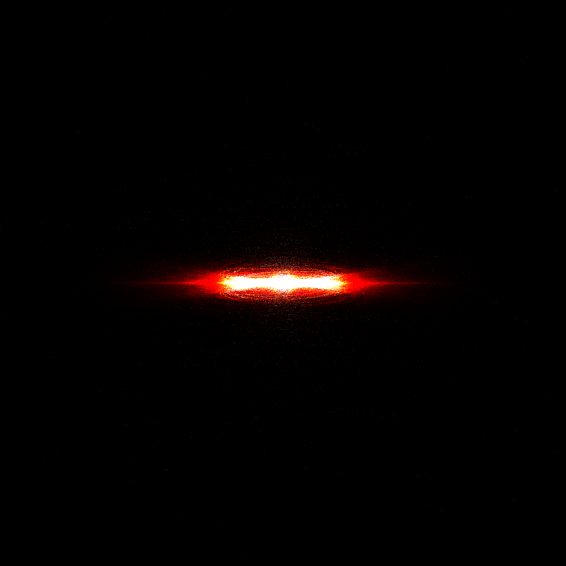
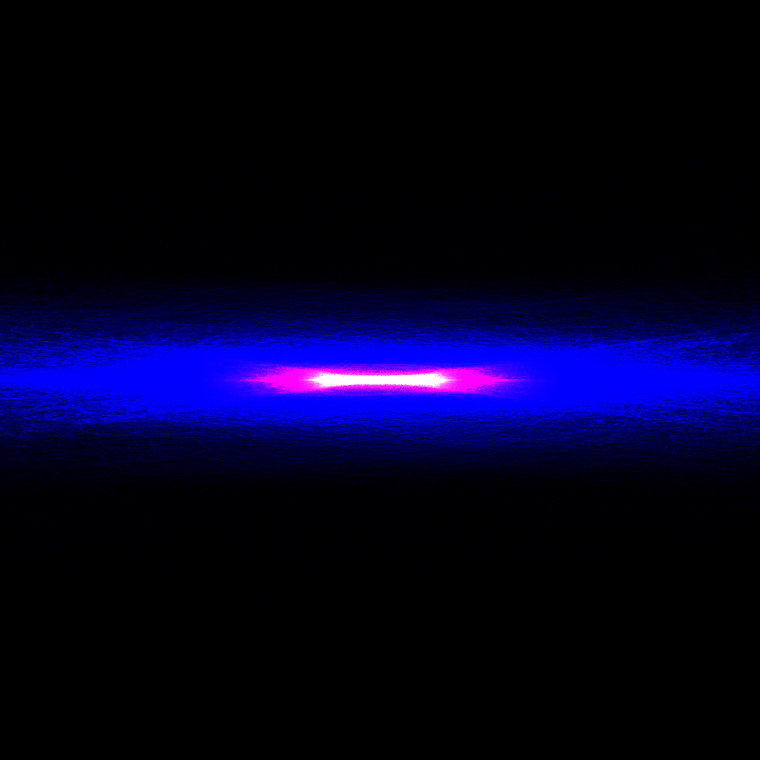
scattering
𝜑 = 90°
𝜃 = 0°
thermal
𝜑 = 90°
𝜃 = 0°

Slide 4
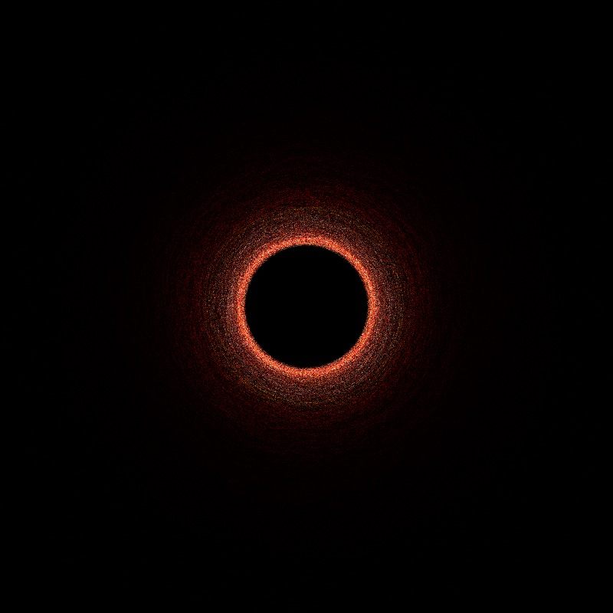
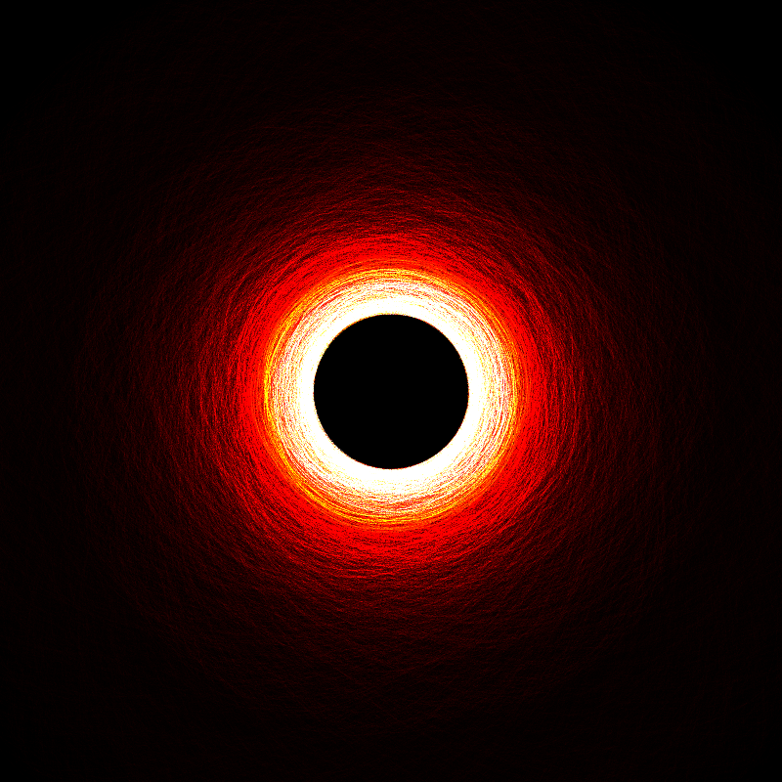
“ring”, N_{p} = 100
𝜑 = 0°
𝜃 = 0°
“ring”, N_{p} = 1000
𝜑 = 0°
𝜃 = 0°

Slide 5
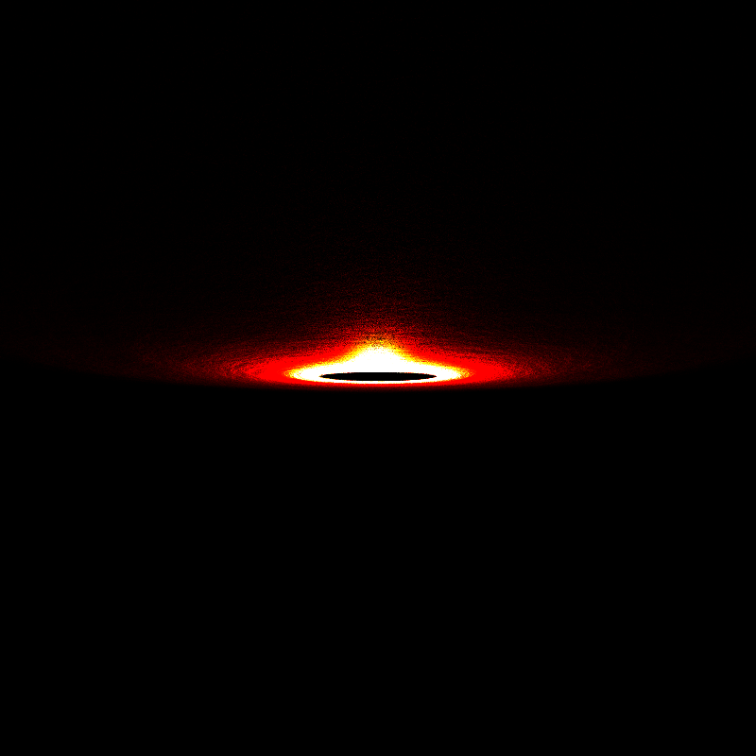
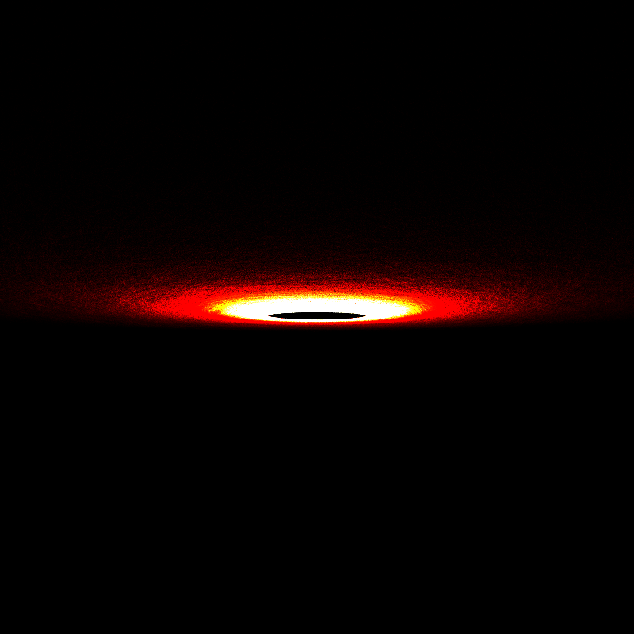
“bar”, HG combination
𝜃 = 95°
𝜑 = 5°
“bar”, single HG
𝜃 = 95°
𝜑 = 5°

